Slide 1
Welcome to Georgetown!
26 June 2017
Notes:
Shady: Icebreaker and Introduction

Slide 2
Schedule (Today)
Time | Topic/Activity
10:00 – 11:30 | Welcome Orientation & CFMI Tour
11:30 – 12:30 | Introduction to the Brain Imaging the Brain with MRI
12:30 – 13:00 | Introduction to Adolescent Development Study (ADS)
13:00 – 13:30 | MRI Lab 1
13:30 – 14:30 | Lunch @ Epicruean
14:30 – 16:00 | Assessing MR Images for Quality Quantitative Quality Assessment Metrics

Slide 3
Market Rx
CFMI
Epicurean
Starbucks
Vital Vittles
Food Trucks
Wisemiller Deli
GUTS Bus
“Depot”

Slide 4
CFMI – General Info
Center for Functional and Molecular Imaging (CFMI)
Started in 2003 with a $3.2M in funding from Georgetown University Medical Center (GUMC)
CFMI is a “Shared Resource” –
Many labs come here to scan including from the surrounding universities and hospitals
Research dedicated
The lab offers a number of techniques for imaging the brain:
High density EEG (256 channels)
NIRS (Near Infrared Spectroscopy)
MRI – 3T scanner

Slide 5
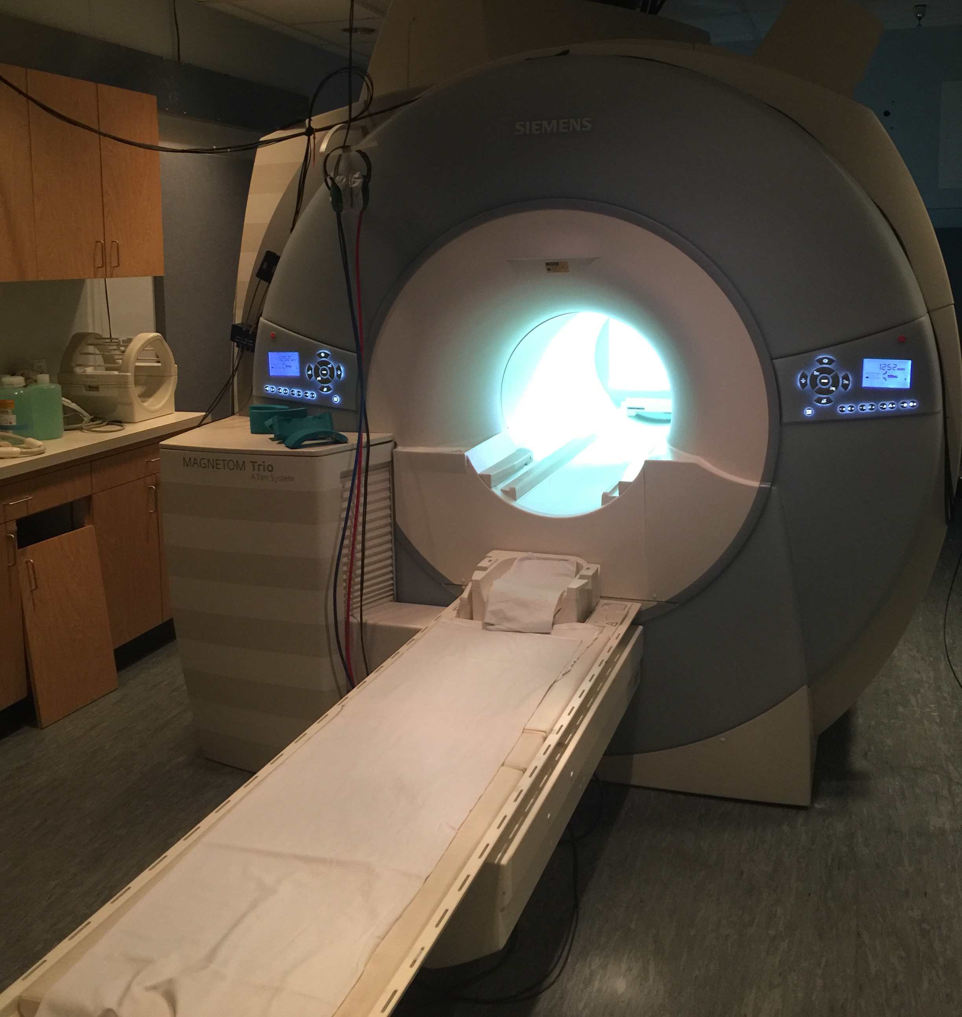
Our MRI Scanner 3T: can lift something ~9x as heavy as 2 ton car!

Slide 6
CFMI Basic Safety & General Rules
Main safety concern is the MRI scanner
Massively powerful magnet at heart of any MRI scanner
Safety First
Stay out of scanner room (all of the dangers live in that one room)!!
Don’t press buttons in console room!
Laboratory is open all summer long and many studies are underway and include many different populations
Stay in this mini-computer lab area and offices
Do not interact with or talk to participants or investigators from other labs
Respect confidentiality

Slide 7
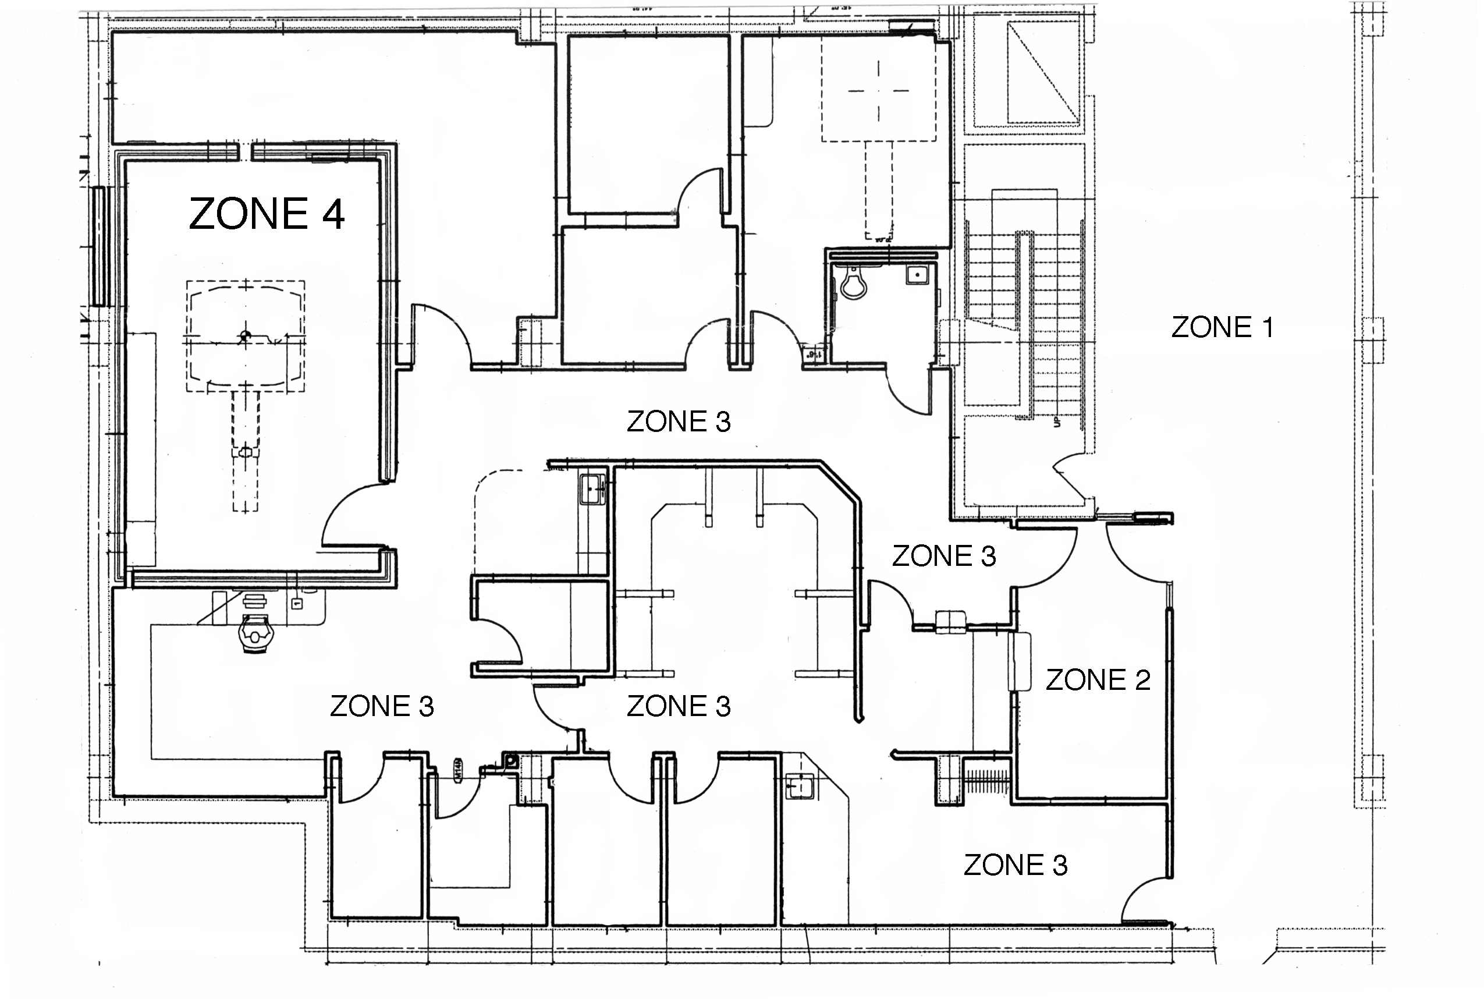
CFMI Safety Zones
Notes:
John start

Slide 8
A few things to keep in mind…
Data is being collected on computer usage to estimate learning curves for FreeSurfer
Only being used as data for paper we hope to publish on this summer camp (web surfing, FB, etc. totally OK and not tracked)
There is a very powerful magnet in this facility, abide by all safety regulations especially MRI Safety Zones.
Remember! Experiments are being conducted during all hours. Avoid wandering into the console room without supervision.
Tour next! Questions? Slack!
Notes:
Transition to slack intro and anatomy

